Slide 1

Project Title - Seasonal Agriculture Performance Analysis
Student Name - Yeru Meghana
College Name - Sridevi Women’s Engineering College
AICTE STU ID : STU6818b916d73c91746450710

Slide 2

PROBLEM STATEMENT
Agricultural activities are influenced by seasonal variations in environmental conditions, farming practices, resource availability and market conditions. As a result, agricultural performance may differ from one season to another.
However, raw agricultural data does not clearly explain how agricultural performance changes across seasons or what patterns can be observed in different seasonal conditions.
The problem is to analyze the given agricultural dataset and investigate seasonal differences in agricultural performance by identifying meaningful patterns, trends, relationships and variations within the available data.

Slide 3
Project Description
This project focuses on analyzing agricultural performance across Kharif, Rabi, and Zaid seasons using a dataset containing 4,000 farm records. The analysis examines environmental conditions, agricultural inputs, irrigation practices, crop production, water usage, and economic performance.
Data preprocessing is carried out to identify and handle missing values and prepare the dataset for further analysis. Exploratory Data Analysis and statistical techniques are then applied to compare seasonal performance and identify meaningful patterns, variations, and relationships. The analysis focuses on yield, production, water efficiency, revenue, cost, profit, environmental conditions, irrigation methods, and disease/pest risk.
The final objective is to generate evidence-based insights and recommendations that can support better seasonal agricultural planning and decision-making.

Slide 4

WHO ARE THE END USERS?
Farmers
Use insights on crop performance, seasonal conditions, water usage, and profitability for better planning.
Agricultural Planners
Compare seasonal and regional performance to support agricultural planning.
Agriculture Departments
Identify seasonal patterns, resource usage, and areas requiring attention.
Researchers & Data Analysts
Use the analysis to study agricultural trends and relationships.
Agricultural Organizations
Support resource management and performance improvement.
Policy Makers
Use evidence-based insights to support agricultural planning and decision-making.

Slide 5

Technology Used
Programming
Python
Data Analysis
Pandas
NumPy
Data Visualization
Matplotlib
Seaborn
Development Environment
Jupyter Notebook / Google Colab
Dataset
CSV

Slide 6
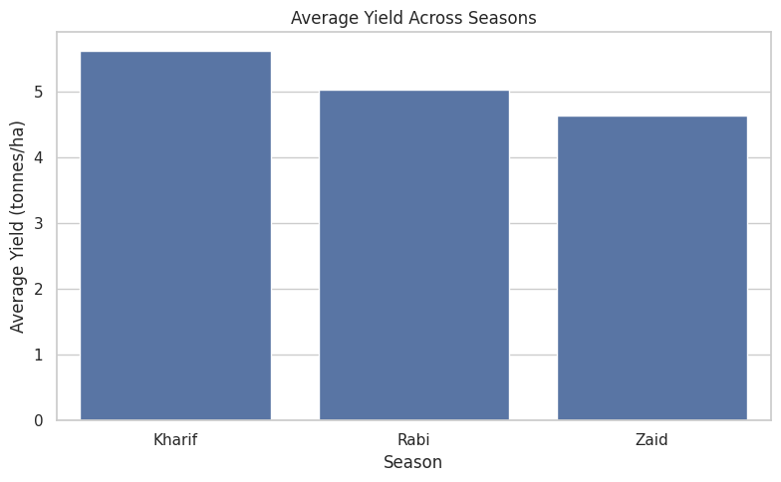
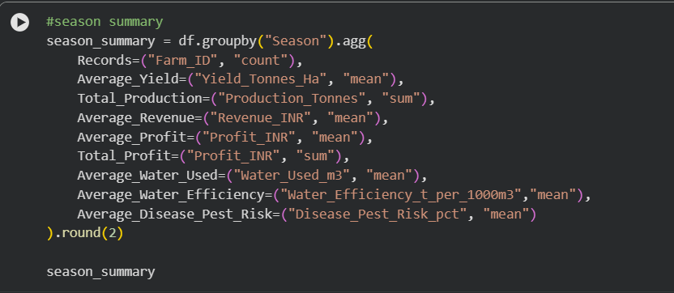
RESULTS

Slide 7
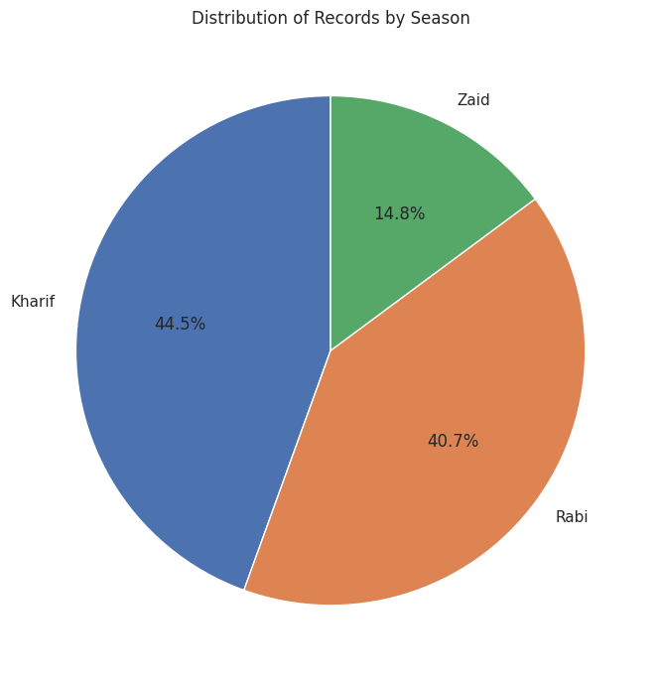
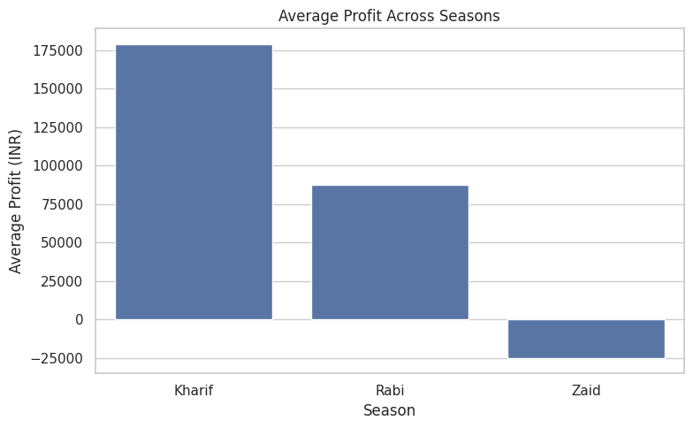
RESULTS

Slide 8
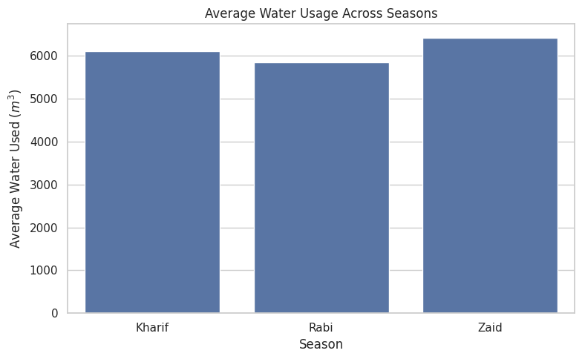
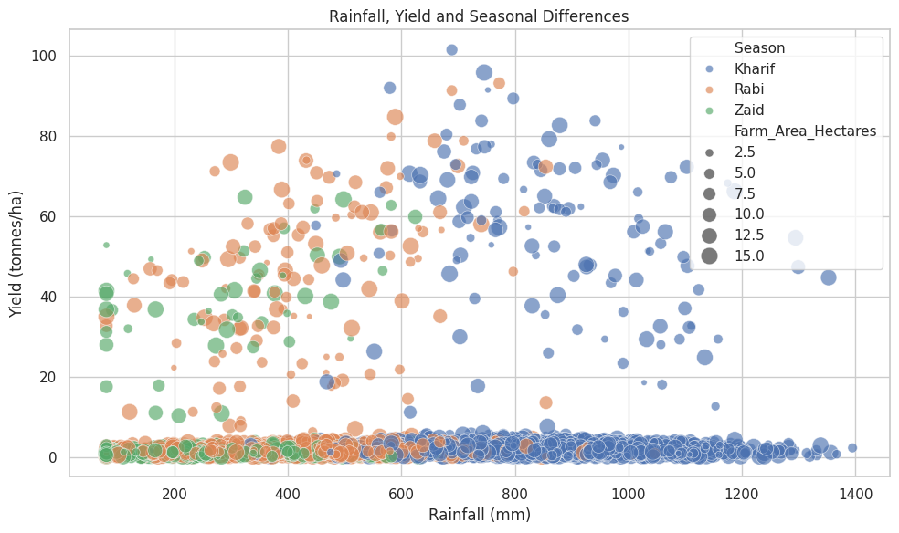
RESULTS

Slide 9
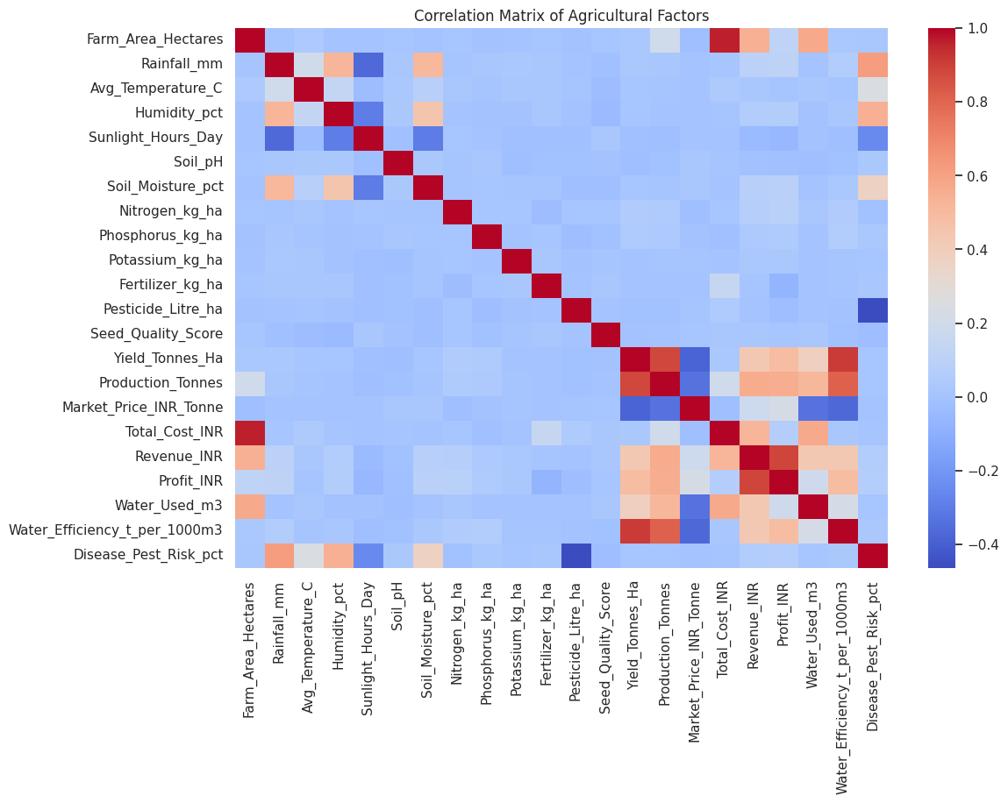
RESULTS

Slide 10
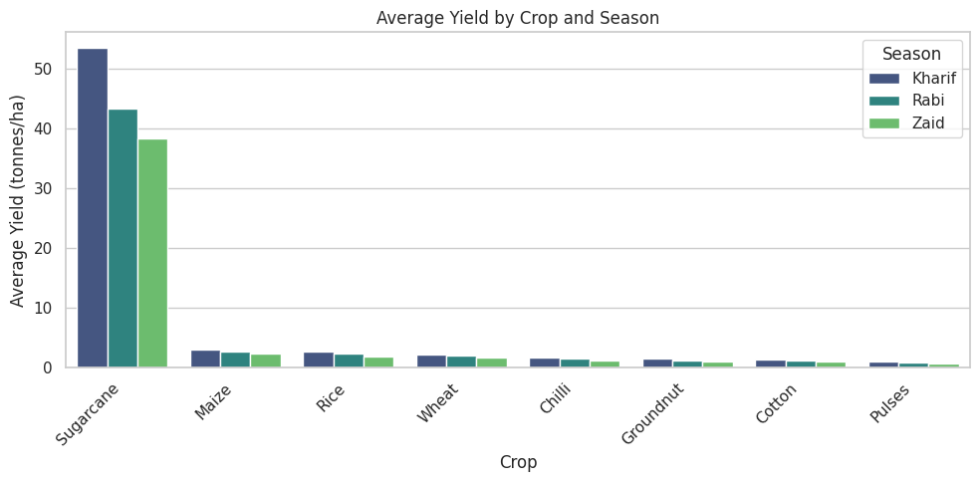
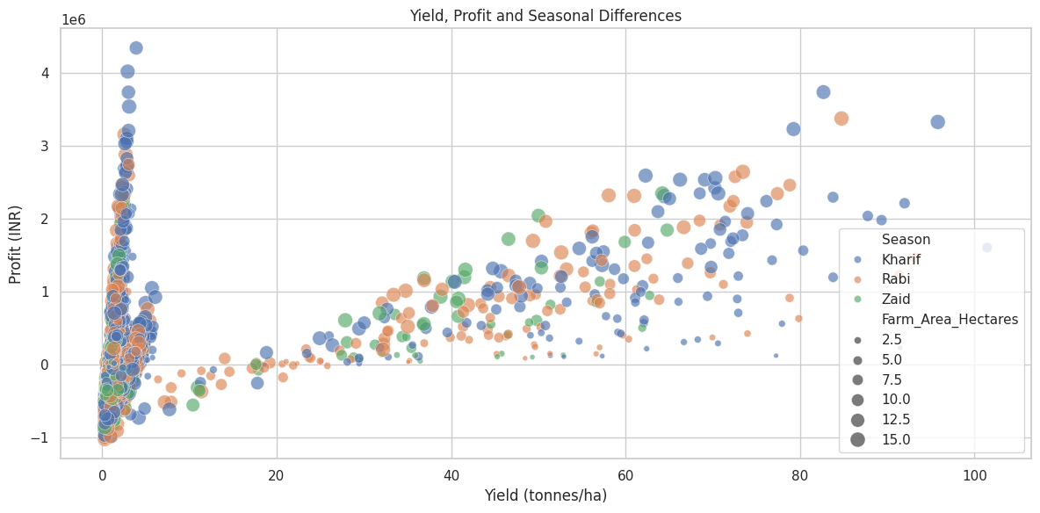
RESULTS

Slide 11
Future scope
Develop predictive models to forecast crop yield and profitability for different seasons.
Integrate real-time weather and environmental data for better agricultural planning.
Build a dashboard to monitor crop performance, water usage, and economic outcomes.
Apply machine learning techniques to identify factors affecting crop yield and profit.
Extend the analysis with more regions, crops, and historical data.
Develop a crop recommendation system based on seasonal and environmental conditions.
Use the analysis to support efficient water and resource management.

Slide 12
GitHub Link
GitHub Repo Link

Slide 13

VOIS Course completion certificate -
Course name- Data Visualization

Slide 14
Thank you
- Yeru Meghana
.
.

